Slide 1
SmartEduTrack: WiFi-Based Student Attendance System
CSE7101- Capstone Project
Review-1
Batch Number: IST_4
Under the Supervision of,
Dr.Poornima S
Assistant Professor
School of Computer Science and Engineering
Presidency University
Roll Number | Student Name
20221IST0023 | G DHANUSH
20221IST0004 | ANOOP KUMAR
20221IST0006 | NAVYA B
Name of the Program: Information Science and Technology
Name of the HoD: Dr. Pallavi R
Name of the Program Project Coordinator: Ms. Benitha Christinal J , Dr. Afroz Pasha
Name of the School Project Coordinators: Dr. Sampath A K , Dr. Geetha A

Slide 2
Content
Abstract
Literature Survey
Objectives
Existing Methods and Drawbacks
Proposed Methods and Feasibility Study
Architecture Diagram
Modules
Hardware and Software Details
Timeline
References

Slide 3
Abstract
Manual attendance consumes time and is prone to errors.
Traditional biometric/RFID systems require costly hardware.
Proposed: WiFi-based automatic attendance via student devices.
Benefits: Saves time, reduces proxy, integrates with records.
Approach: Mobile app + backend database with WiFi authentication.

Slide 4
Problem Statement
Issues with Existing Systems:
- Delays in manual marking
- Risk of proxy attendance
- Biometric/RFID require extra hardware
Gap: Need for low-cost, reliable, non-intrusive method.

Slide 5
Literature Survey
Reviewed 10 research papers:
- MAC-based authentication
- WiFi CSI presence detection
- WiFi fingerprinting for localization
- Biometric, RFID & QR alternatives
Gaps identified: Scalability, cost, hardware dependency, security issues.

Slide 6
Objectives
1. Automate attendance with minimal manual intervention.
2. Use existing WiFi infrastructure – no new hardware.
3. Enhance security using MAC addresses.
4. Provide mobile app interface for students.
5. Give faculty real-time reports & analytics

Slide 7
Existing Methods & Drawbacks
Manual: Slow, error-prone
Biometric: Expensive, privacy issues
RFID: Risk of card sharing
QR Code: Proxy possible, time-consuming
Proposed WiFi-based system:
- Faster
- Low cost
- Secure
- Automated

Slide 8
Proposed Methodology
- Students connect automatically to classroom WiFi
- Server checks MAC + timestamp
- Attendance logged in DB
- Faculty dashboard for updates
- Admin access for analytics & backup

Slide 9
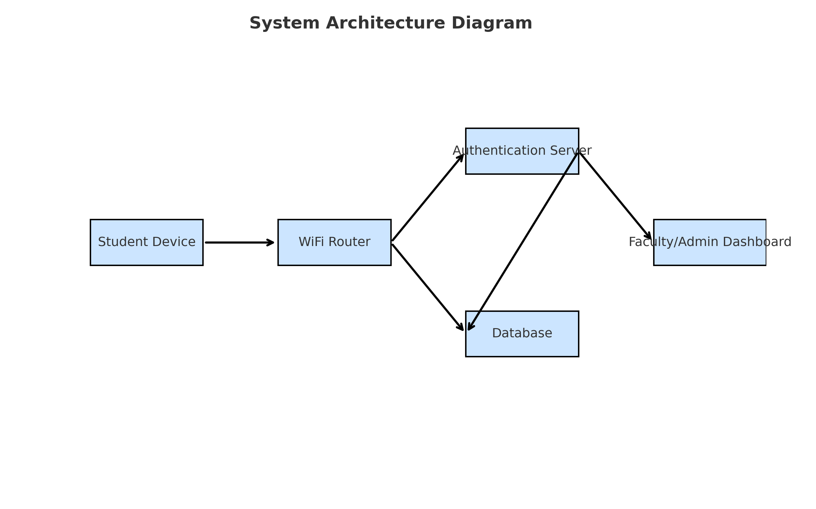
System Architecture

Slide 10
System Modules
1. Authentication Module
2. Database Module
3. Mobile Application Module
4. Faculty Dashboard Module
5. Admin Module

Slide 11
Hardware & Software Requirements
Hardware:
- Smartphones, WiFi routers, server
Software:
- Android Studio (Java/Kotlin)
- Backend: Node.js / Flask
- Database: MongoDB/MySQL
- Tools: VS Code, Firebase (optional)

Slide 12
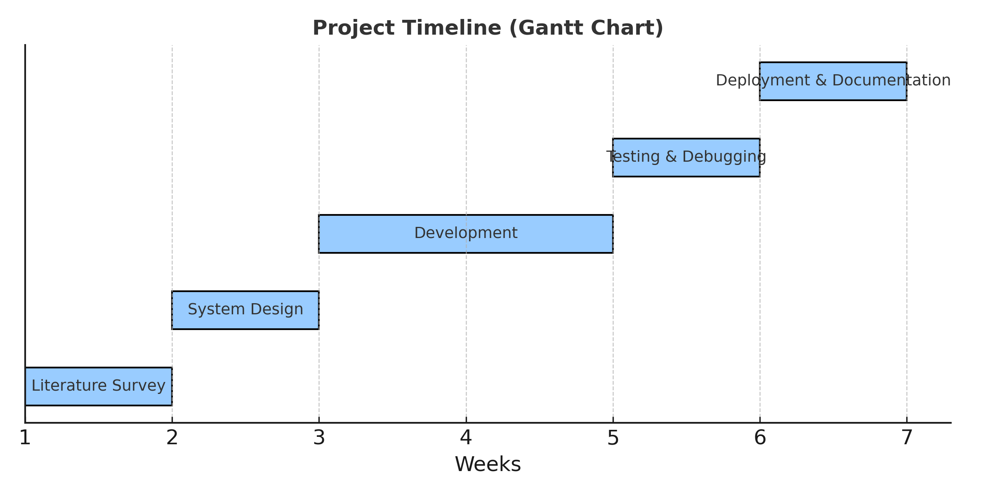
Project Timeline (Gantt Chart)

Slide 13
Advantages & Limitations
Advantages:
- Low cost
- Reduces manual errors
- Prevents proxy
- Saves time
Limitations:
- Requires smartphones
- WiFi must be stable
- Security depends on MAC filtering

Slide 14
Future Scope
- AI-powered fraud detection
- Integration with university ERP
- Cloud-based scalability
- Blockchain for secure logs
- Cross-platform apps (Android & iOS)

Slide 15
References of IEEE papers
[1] D. Takahashi et al., 'IEEE 802.11 user fingerprinting and applications,' IEEE, 2021.
[2] J. Zheng, K. Li, and X. Zhang, 'Wi-Fi fingerprint-based indoor localization,' Sensors, 2022.
[3] F. Wang et al., 'Joint Activity Recognition and Indoor Localization with WiFi,' arXiv, 2021.
[4] C. M. Mesa-Cantillo et al., 'Non-Intrusive Human Presence Detection via WiFi CSI,' IEEE, 2020.

Slide 16
References of IEEE papers
[5] M. Choi et al., 'Attendance Check System and Implementation for Wi-Fi,' IEEE, 2019.
[6] IJIREEICE, 'Attendance Monitoring System Utilizing Wi-Fi,' 2018.
[7] ResearchGate, 'Wi-Fi Based Smart Attendance Monitoring System,' 2021.
[8] J. Infotel, 'Revolutionizing Attendance Using ESP-NOW,' J. Infotel, 2024.
[9] M. Rahaman, 'SmartPresence: Wi-Fi-based attendance,' Springer, 2025.
[10] S. He et al., 'Wi-Fi Fingerprint-Based Indoor Positioning: A Survey,' IEEE, 2019.

